Slide 1



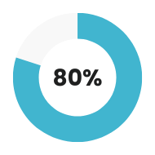
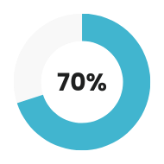

Zaapa
Design and Implementation of
Road Sign and State notification mobile Application
Task 7
Design
Implementation
Explore Now
Let’s Listen Attentively

Slide 2
Zaapa
Outline
Introduction
Literature Review
Analysis & Design
Implementation & Results
Conclusion

Slide 3
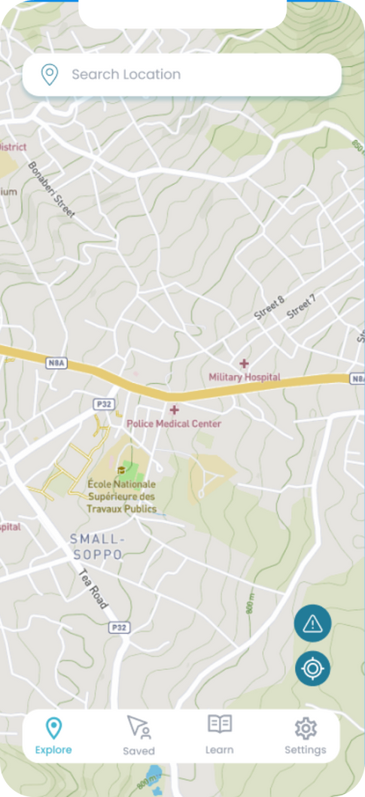
Zaapa
Introduction
Road safety is a critical concern worldwide, with millions of accidents occurring annually due to various factors, including poor road conditions, inadequate signage, and lack of real-time information for drivers.

Slide 4
Zaapa
Litterature Review
In recent years, road safety and traffic management have become critical issues in urban areas due to increasing vehicle numbers and complex traffic patterns. Effective solutions are needed to enhance road safety, manage traffic congestion, and improve the overall driving experience.

Slide 5
Zaapa
Problem Statement
Navigating roads efficiently and safely is a universal concern for drivers, yet current methods of accessing critical information about road conditions, weather hazards, and real-time traffic updates often fall short. Users face challenges in receiving timely notifications tailored to their preferences.

Slide 6
Zaapa
General Objectives
To develop a comprehensive Road State and Road Sign Notification Mobile App that provides real-time updates on road conditions, traffic congestion, and road signage to enhance road safety and improve the driving experience in urban areas, with a focus on Buea, Cameroon.

Slide 7
Specific Objectives
01
Enhance Road Safety
02
Improve Traffic Flow
03
Increase Signage Visibility and Compliance

Slide 8
Zaapa
Analysis and Design
This section focuses on planning and preparing for the development of the Road State and Road Sign Notification Mobile App.
Requirement Gathering
UI Design
System Modeling
Database Design

Slide 9
Zaapa
Requirement Gathering & Analysis
01
Stakeholders identification
02
Requirement Gathering Techniques
03
Selection criteria
04
Software Requirements Specifications

Slide 10
Zaapa
System Modeling & Design
System design and modelling are critical phases in the development of robust, efficient, and
scalable systems. The modeling process involves defining the core entities, their attributes, and
the relationships among them.
Context Diagram
Use case Diagram
Sequence Diagram
Activity Diagram
Deployment Diagram

Slide 11
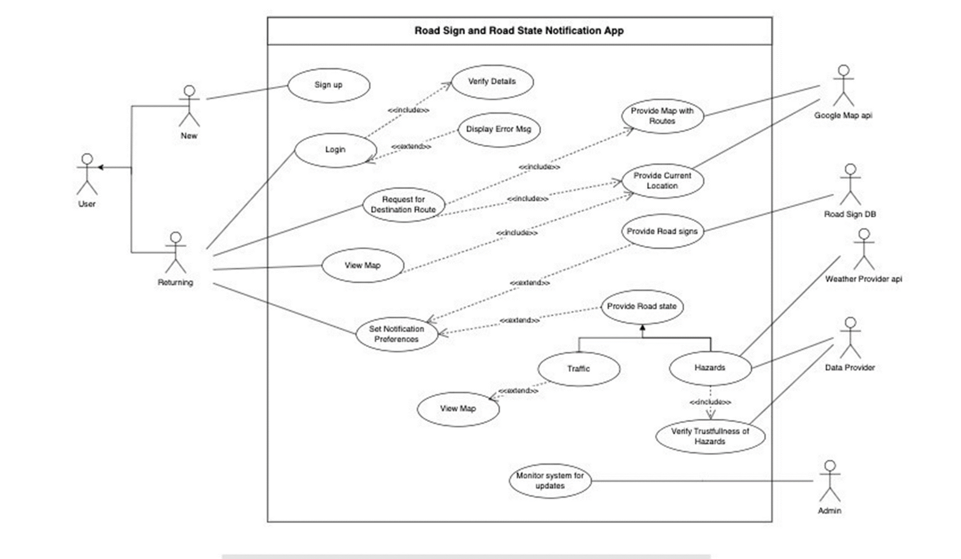
Zaapa
Use case Diagram

Slide 12
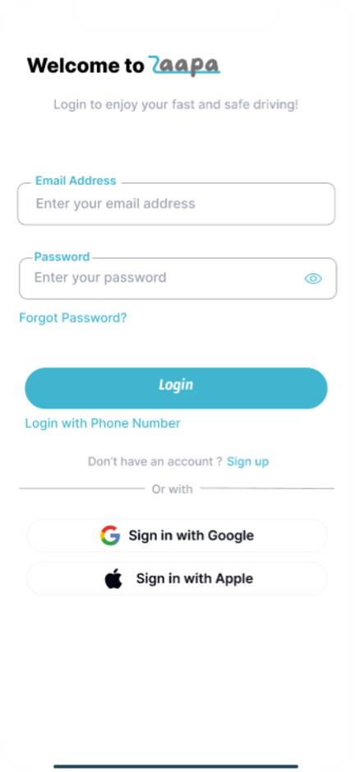
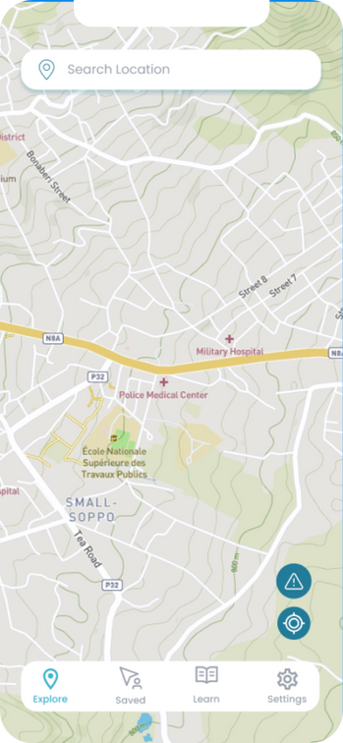
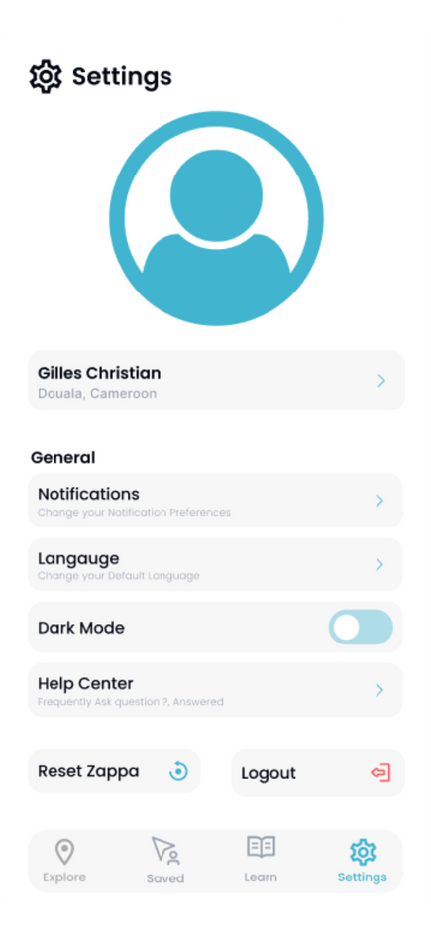
Zaapa
UI Design (using Figma)
Unity
Hierarchy
Alignment

Slide 13
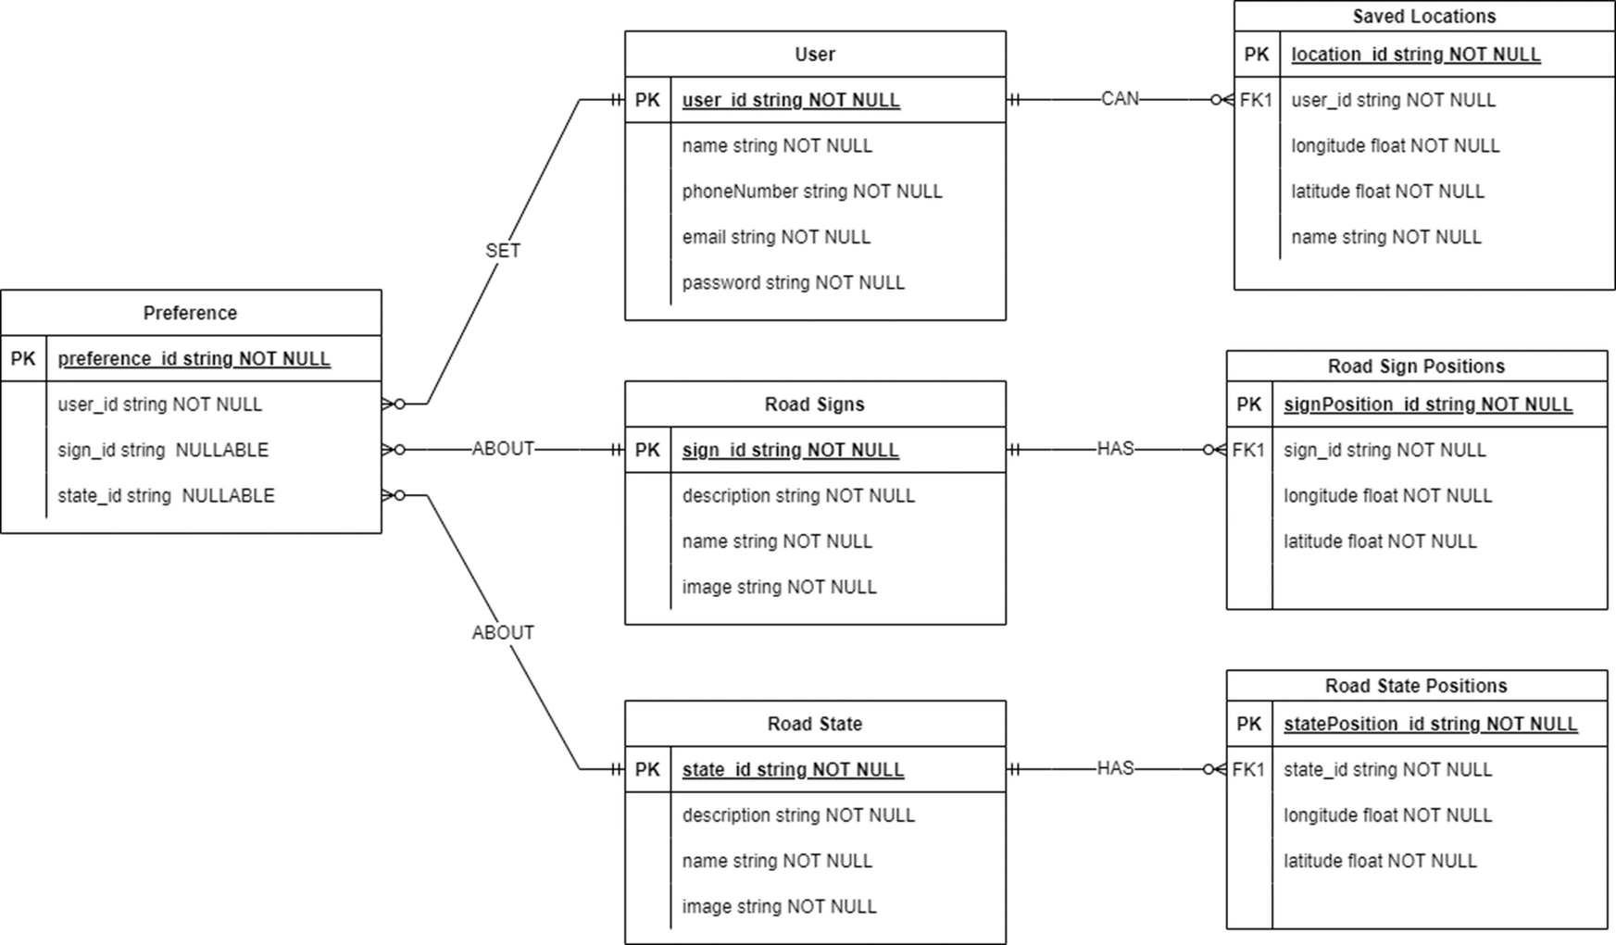
Zaapa
Database Design

Slide 14
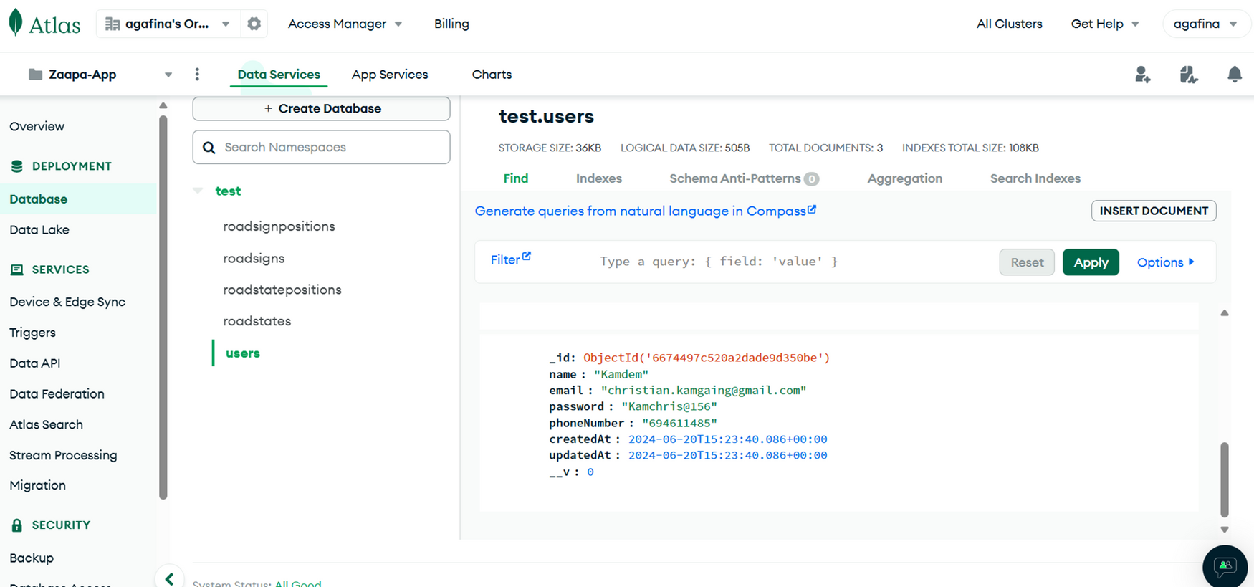
Zaapa
Database Implementation

Slide 15
Zaapa
Implementation & Result
This section focuses on planning and preparing for the development of the Road State and Road Sign Notification Mobile App.
Frontend Implementation
Backend Implementation

Slide 16
Zaapa
Frontend Implementation
This section describes the path through the implementation of the frontend designed above. A component based approach was used, were each screen was developed in a separate file and the different files were interconnected using the react-navigation component.
React Navigation
Axios
Expo/vector-icons
Joi
React-native-maps
Mapbox/Polyline

Slide 17
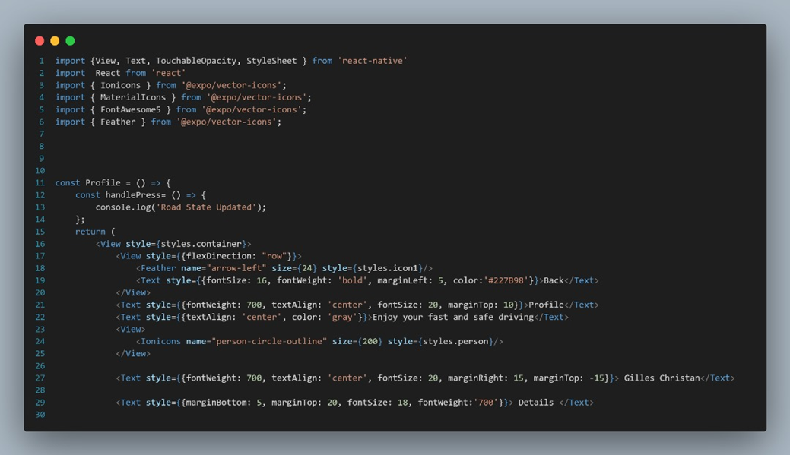
Zaapa
Frontend Implementation

Slide 18
Zaapa
Backend Implementation
The backend of the Zaapa App is responsible for processing client requests, managing data, performing business logic, and ensuring the application's security and scalability. The backend was developed using Node.js with Express.js as the framework.
Architecture and Design
Api Endpoints
Data Validation
Security Measures
Error Handling

Slide 19
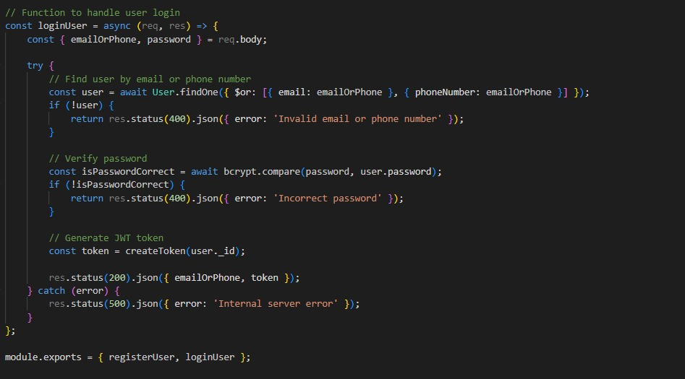
Zaapa
Backend Implementation(Authentication)

Slide 20
Zaapa
Conclusion
The implementation of our road state road sign notifications project marks a significant step forward in leveraging technology to enhance road safety and user convenience. Throughout the project, careful attention was paid to user experience, resulting in a seamless navigation and notification system that meets the needs of modern drivers.

Slide 21

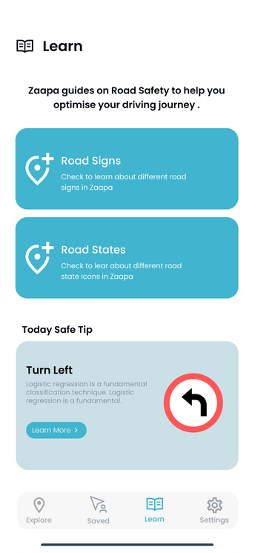
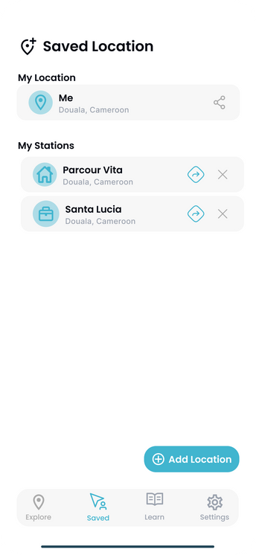
Zaapa
Thank You

